Slide 1
PRESENTATION ON
MIZORAM RIGHT TO PUBLIC SERVICES ACT, 2015

Slide 2
THIL TUM
He Dan Mizoram Right to Public Services Act, 2015 in a tum ber chu sawrkar in mipui te hnena “service” a pek chhuah thin te hun bi tiam chhunga a diltu hnena pek chhuah zat zat ani
To provide for the delivery of notified public services to the people of the State of Mizoram within the stipulated time limit

Slide 3
“SERVICE” CHU ENGNGE NI?
Sawrkar in mipuite hnena an mamawh a pek chhuah thin hi “SERVICE” tih ani, sawrkar mawhphurhna mipuite mamawh anih angin “PUBLIC SERVICE” an ti bawk
Entirna:
1. Transport Department in Driving License a pek te
2. PHE Department in water supply connection a pek te
3. RD Department in Job Card a pek te
4. Social Welfare Department in Disability Certificate a pek
5. Taxation Department in Way Bill a pek te

Slide 4
ENG VANGIN NGE HE DAN HI KAN NEIH?
Sawrkar in mipuite hnena “service” kan pek thinah tul lova tihkhawtlai a awm fo thin
Service diltute hnena danin a phut ang ni lo “pawisa” lo dil tlat te a awm zauh zauh bawk
Mipuite mamawh rang taka ngaihtuah zung zung thei sawrkar (responsive administration) kan neih theih nan

Slide 5
STATE DANGAH HETIANG DAN HI TUTE NGE HMANG VE?
Sl. No. | Dan hming | State | Hman tan ni
1 | The Madhya Pradesh Lok Sewaon Ke Pradan Ki Guarantee Adhiniyam | Madhya Pradesh | 18.08.2010
2 | The Uttar Pradesh Janhit Guarantee Adhyadesh | Uttar Pradesh | 13.01.2011
3 | The Delhi (Right of Citizen to Time Bound Delivery of Services) Act, 2011 | Delhi | 03.04.2011
4 | The Jammu and Kashmir Public Services Guarantee Act, 2011 | Jammu & Kashmir | 13.04.2011

Slide 6
STATE DANGAH HETIANG DAN HI TUTE NGE HMANG VE?
Sl. No. | Dan Hming | State | Hman tan ni
5 | Bihar Right to Public Services Act, 2011 | Bihar | 15.08.2011
6 | The Rajasthan Guaranteed Delivery of Public Services Act, 2011 | Rajasthan | 21.09.2011
7 | The Uttarakhand Right to Service Act, 2011 | Uttarakhand | 04.10.2011
8 | Himachal Pradesh Public Services Guarantee Act, 2011 | Himachal Pradesh | 17.10.2011
9 | The Punjab Right to Service Act, 2011 | Punjab | 20.10.2011
10 | The Jharkhand Right to Service Act, 2011 | Jharkhand | 15.11.2011

Slide 7
STATE DANGAH HETIANG DAN HI TUTE NGE HMANG VE?
Karnataka
Kerala
Assam
Gujarat
Chhattisgarh
Haryana
Odisha
Maharashtra

Slide 8
ENGTIK AH NGE ASSEMBLY IN A PASS?
The Mizoram Right to Public Services Act, 2015 hi Mizoram Legislative Assembly in tahrik ni 24.03.2015 khan lungrual takin an pass a
Mizoram Larsap (Governor) in tahrik ni 25.03.2015 khan a pawm a, Dan a lo ni ta chiah ani

Slide 9
ENGTIK AH NGE HE DAN HI KAN HMAN TAN?
The Mizoram Right to Public Services Act, 2015 hi Larsap in thuchhuah a siam angin December ni 1, 2015 khan hman tan ani
He dan hnuaia dan tesep The Mizoram Right to Public Services Rules, 2015 pawh December ni 1, 2015 atanga hman tan ani

Slide 10
HE DAN HIAN TU TE NGE A HUAM?
The Mizoram Right to Public Services Act, 2015 hian Mizoram pum pui a huam a (mahse Sixth Schedule hnuaia Autonomous District Council ten he dan hi an adopt loh chuan a huam chuang lo)
a) Sawrkar hnathawk nghet te
b) Hmun dang atanga sawrkar hnathawk a hawh lailawk te c) Tualchhung sawrkar a hnathawk te
d)Sawrkar in sum leh paia a tuamhlawm pawl a hnathawktute a huam vek ani

Slide 11
HE DAN HIAN TU TE NGE A HUAM LOH?
A kah pah (casual) leh ni bi (daily rate) a thawk te
Contract a sawrkar in a rawih te (Contract an ziah in a phal anih loh chuan)
Sawrkar mi pawimawh bik, an hnathawh leh kalphung India danpui (Constitution) in a tarlan te
Sawrkar hnathawk India Danpui hnuaia Schedule parukna (Sixth Schedule) hnuaia inrelbawl bik ah te

Slide 12
“SERVICE” HRANG HRANG TE ENGTIA HE DAN HUANG CHHUNGA DAH NGE A NIH?
Section 4(1) in State sawrkar ah thuneihna a pek angin he dan hnuaiah hian mipui mamawh “service” hrang hrang te a tul dan ang zelin dah/sengluh theih ani
He dan hnuaia “service” dah tawh chu a diltu hnena pek chhuah hun tur “hunbi tiam” (stipulated time limit) siam zel bawk tur ani
He dan hnuaia “service” dah tawh chu a pe chhuaktu tur “Designated Officer” State sawrkar in a ruat zel bawk ang {Sec 4(2)}

Slide 13
HE DAN HNUAIA “SERVICE” DAH TAWH TE A HRIAT THEIH EM?
“Service” hming | Department | Designated Officer | Hunbi tiam
Driving License Smart Card tel a pek chhuah | Transport | DTO | Ni 4
Driving License Smart Card tel a renew | Transport | DTO | Ni 2
Way Bill | Taxation | Asst. Commissioner te | Ni 3
MGNREGA hnuaia Job Card pek | RD | BDO | Ni 15
Disability Certificate pek | Social Welfare | Asst. Director | Ni 10

Slide 14
HE DAN HNUAIA “SERVICE” DAH TAWH TE A HRIAT THEIH EM?
“Service” hming | Department | Designated Officer | Hunbi tiam
Tui connection nei tu hming thlakna | PHE | SDO | Division ah : Ni 7 Hmun dangah : Ni 15
Vehicle fitness certificate | Transport | DTO | Ni 1
MGNREGA hnuaia “unemployment allowance” | RD | BDO | Ni 15
Professional Tax Clearance Certificate | Taxation | Asst. Commissioner | Ni 3

Slide 15
HE DAN HNUAIA “SERVICE” DAH TAWH TE A HRIAT THEIH EM?
“Service” hming | Department | Designated Officer | Hunbi tiam
Mimal hnena tui supply connection pek | PHE | SDO | Dilna thehluh atanga sanction : Ni 30 2. Pawisa sen tur thehluh atanga tui supply pek : Ni 30

Slide 16
“SERVICE” ENGZAT NGE ?
The Mizoram Right to Public Services Act, 2015 hnuaia “service” dah/sengluh tawh hi tun dinhmun ah 46 a awm mek.
Mizoram sawrkar chuan he dan hnuaiah “service” hrang hrang dah/sengluh belh zel a tum ani
Chung service neitu Department te chu:
1) Transport 2) Taxation 3) Social Welfare 4) Rural Development 5) Finance 6) PHE

Slide 17
MIPUI TE’N DIKNA CHANVO ENGNGE KAN NEIH?
The Mizoram Right to Public Services Act, 2015 hnuaia “service” dah/sengluh tawhte hi a diltu mipui te’n hunbi tiam chhunga ngeia hmuh ngei hi an dikna chanvo (right) ani {Sec 5}
He dan hnuaia “service” la dah/sengluh ve lohte hi chu a diltu mipui te’n engemaw hunbi tiam chhunga hmuh ngei theihna dikna chanvo kan nei lem lo

Slide 18
MIPUI TE’N ENGNGE TIH VE TUR KAN NEIH?
He dan hnuaia “service” te dilna kan thehluhin fel fai taka dilna form awm apiang te ziah leh document thehluh ngai apiang thehluh tur ani
He dan hnuaia “service” te dilna kan thehluhin Designated Officer in a dawng ngei tih hriatna “Acknowledgement Receipt” lak nachang hriat tur ani

Slide 19
DILNA FORM LEH FEE ?
He dan hnuaia “service” te dil turin a hrangin he dan hi chuan dilna form a hrangin a siam lo, kha “service” pe tu Department erawhin dilna form an siam thin tlangpui
He dan hnuaia “service” te dil turin a hrangin he dan hian fee bituk engmah a nei lo, kha “service” pe tu Department erawhin fee an siam thei thung

Slide 20
SAWRKAR HNATHAWKTE MAWHPHURHNA ENGNGE AWM?
Sawrkar hnathawk “service” pe chhuaktu “Designated Officer” a ruat chuan he dan hnuaia “service” dah tawh te chu a diltu hnenah hunbi tiam chhungin a pe ngei tur ani {Sec 6}
Designated Officer chuan Officer dangte emaw sawrkar hnathawk dangte tanpuina atul ang zelin a dil thei ang.
Sawrkar hnathawk dangte pawh chu he dan hnuaia atul anga a thawhna ah chuan Designated Officer mawhphurhna la anga ngaih ani ang

Slide 21
SAWRKAR HNATHAWKTE MAWHPHURHNA ENGNGE AWM?
Designated Officer chuan “service” dilna thehluttu hnenah chuan dilna a dawng ngei ani tih lantirna Form-1 hmangin “Acknowledgement receipt” a pe tur ani
Form-1 ah hian document thil tel ngai engemaw a kim loh chuan hunbi tiam ziah luh hrih loh tur ani

Slide 22
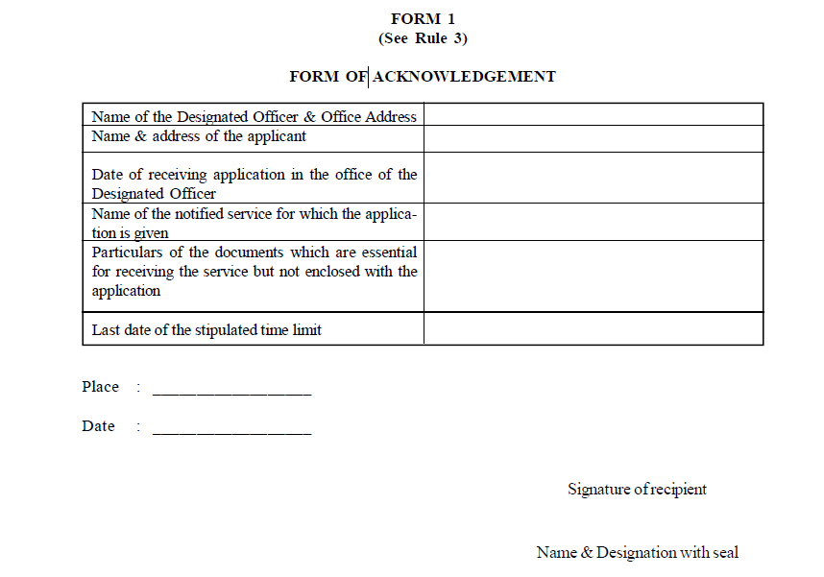

Slide 23
SAWRKAR HNATHAWKTE MAWHPHURHNA ENGNGE AWM?
Designated Officer chuan “service” a pek chhuah turte vantlang hmuh theih turin Notice Board ah tarlang tur tur ani:
a) Designated Officer nihna
b) Lungawilohna thlenna tur pakhatna First Appellate Authority
c) Lungawilohna thlenna tur pahnihna Second Appellate Authority
d) Hunbi tiam chhung
e) Documents thehluh tel ngai te [Rule 5]

Slide 24
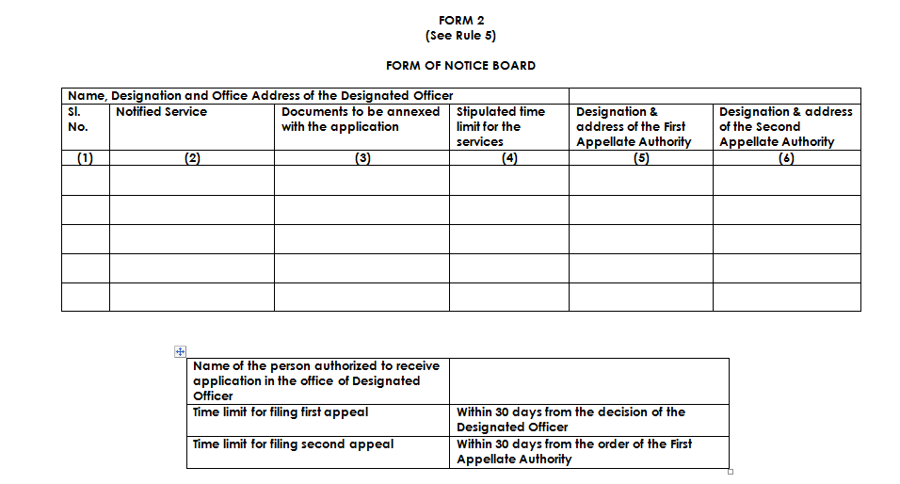

Slide 25
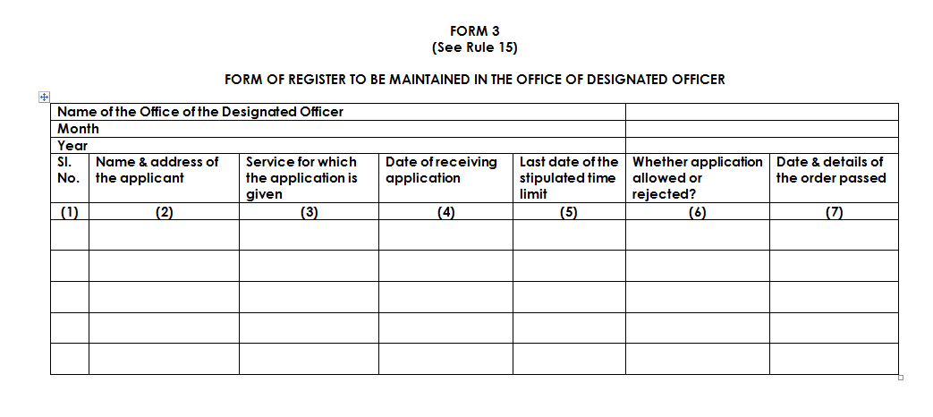

Slide 26
SAWRKAR HNATHAWKTE MAWHPHURHNA ENGNGE AWM?
Designated Officer chuan “service” dilna a dawn chu hunbi tiam chhungin a pe emaw dilna chu chhan leh vang mumal tak nen a hnawl thei ang {Sec 7(2)}
Dilna chu Designated Officer in a hnawl anih chuan a diltu hnenah:
a) Hnawl a nih chhan chiang takin a ziak ang
b) Dilna hnawl anih vanga thuneitu sang zawk hnena thlen theih hun chhung
c) Lungawilohna thlenna tur First Appellate Authority

Slide 27
HUN BI TIAM ENGTIA CHHIAR TUR NGE?
He dan hnuaia “service” pek chhuak hun bi tiam hi dilna Designated Officer emaw sawrkar hnathawk mawhphurtu dang DO in a ruat emaw ten an dawn ni atanga chhiar tan tur ani ang {Sec 7}
Hunbi tiam chhiar nan hian “Sunday” leh sawrkar in “public holiday” a puan te chhiar tel loh tur ani {Rule 4}

Slide 28
LUNGAWILOHNA THU THLENNA
He dan hnuaia lungawilohna thlenna tur pakhatna “First Appellate Authority” leh lungawilohna thlenna tur pahnihna “Second Appellate Authority” te State sawrkar in Section 4(3) hmangin a ruat thei
First Appellate Authority chu Designated Officer aia nihna sang zawk ani tur ani a, chutiangin Second Appellate Authority pawh First Appellate Authority aia nihna sang zawk ani tur ani

Slide 29
LUNGAWILOHNA THU THLENNA : ENG THUNEIHNA NGE AN NEIH?
He dan hnuaia lungawilohna thlenna (Appellate Authorities) te hian Civil Procedure Code, 1908 in Civil Court hnena thuneihna a pek ang an nei ve
a) Document engpawh an endik thei a
b) Designated Officer leh thubuaia lungawilo te a hnena inlan tura koh theihna
c) He dan hnuaia tarlan anga atul danga thuneihna

Slide 30
LUNGAWILOHNA THLEN VAWIKHATNA
Tu in nge lungawilohna thlen thei | Eng vangin nge lungawilohna a thlen ang? | Engtik hun chhung nge lungawilohna thlen theih anih? | Tu hnenah nge lungawiloh vawikhatna thlen theih anih?
“service” dilna siamtu in | “service” dilna hnawl vang emaw hunbi tiam chhunga service pek loh vangin emaw ani thei | Ni 30 (Engemaw harsatna bik riau avanga dilna thlentu in hun tiam chhunga lungawilohna hmasa a thlen theih loh in ni 60 thleng) | Lungawilohna thlenna pakhatna “First Appellate Authority”

Slide 31
LUNGAWILOHNA THLEN VAWIKHATNA
First Appellate Authority chuan lungawilohna a dawn chu ni 30 chhungin a ching fel tur ani [Sec 8(2)]
First Appellate Authority chuan thutlukna siam hma in Designated Officer leh lungawilohna thlentu thu a ngaithla hmasa tur ani [Sec 8(3)]
First Appellate Authority chuan Designated Officer chu service dilna hunbi tiam chhunga pe tur in thupek a siam thei a, tin, lungawilohna thu pawh a hnawl thei bawk [Sec 8(3)]
Lungawlohna thlenna atan hian Fee engmah pek a ngai lo [Rule 6]

Slide 32
LUNGAWILOHNA THLEN VAWIHNIHNA
Tu in nge lungawilohna thlen thei | Eng vangin nge lungawilohna a thlen ang? | Engtik hun chhung nge lungawilohna thlen theih anih? | Tu hnenah nge lungawiloh vawikhatna thlen theih anih?
DO emaw “service” dilna siamtu in | First Appellate Authority thu remna a lungawilohna vangin | Ni 30 (Engemaw harsatna bik riau avanga DO emaw dilna thlentu in hun tiam chhunga lungawilohna a thlen theih loh in ni 60 thleng) | Lungawilohna thlenna pahnihna “Second Appellate Authority”

Slide 33
LUNGAWILOHNA THLEN VAWIHNIHNA
Second Appellate Authority chuan lungawilohna a dawn chu ni 30 chhungin a ching fel tur ani [Sec 9(2)]
Second Appellate Authority chuan thutlukna siam hma in Designated Officer leh lungawilohna thlentu thu a ngaithla hmasa tur ani [Sec 9(2)]
Second Appellate Authority chuan Designated Officer chu service dilna hunbi tiam chhunga pe tur in thupek a siam thei a, tin, lungawilohna thu pawh a hnawl theiin thutlukna dang pawh a siam thei[Sec 9(2)]
Lungawlohna thlenna atan hian Fee engmah pek a ngai lo [Rule 6]

Slide 34
HREMNA
First Appellate Authority in hremna chi hnih a pek theih te [Sec 11(1)]:
Hremna pek chhan tur | Hremna atan pawisa chawitir tur zat | Tu nge hrem tur chu?
Chhan leh vang mumal awm lova a diltu hnena “service” pek loh | Rs 500/- atanga Rs 5,000/- inkar | Designated Officer
Chhan leh vang mumal awm lova “service” dilna tihkhawtlai | Nitin Rs 250/- zel a tihkhawtlai hun chhung atan ani anga, mahse Rs 5,000/- aiin a sang thei lo | Designated Officer

Slide 35
HREMNA
Second Appellate Authority in a hremna a pek theih [Sec 11(2)]:
He dan hnuaia hremna te hi dan dangin hremna a pek te bakah a hranga kal ani [Sec 11(4)]
Hremna pek chhan tur | Hremna atan pawisa chawitir tur zat | Tu nge hrem tur chu?
First Appellate Authority in chhan leh vang mumal awm lova lungawilohna thlen vawikhatna thu hun tiam chhunga a rem lohvin | Rs 500/- atanga Rs 5,000/- inkar | First Appellate Authority

Slide 36
HREMNA
Section 11 hnuaia hremna pek an awm anih chuan a copy chu a hnuaia mite hi pek tel ngei tur ani:
Drawing and Disbursing Officer (hremna dawngtu hlawh atanga hremna zat lo la turin)
Treasury Officer
Hremna dawngtu thawhna Department [Rule 12]

Slide 37
SAWRKAR ACCOUNT A HREMNA CHHUNLUHNA TUR

Slide 38
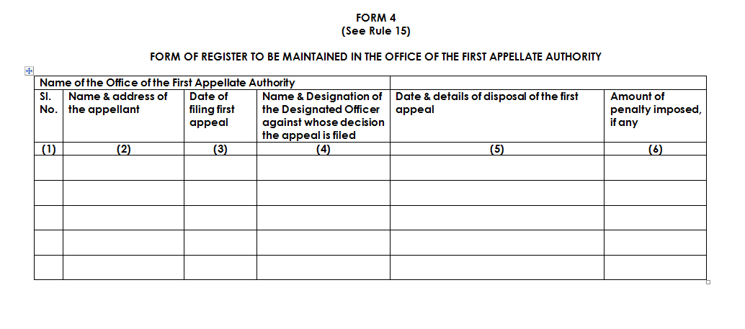

Slide 39
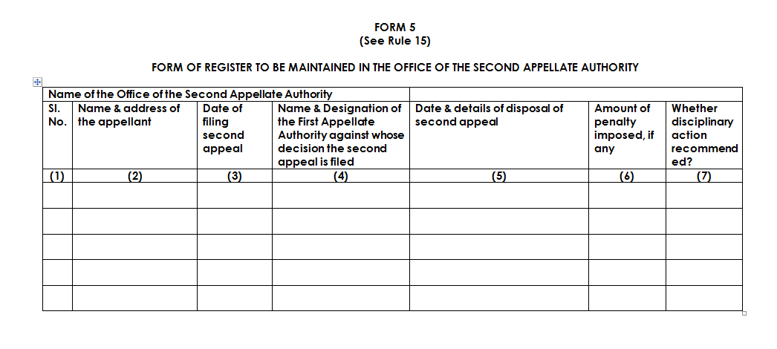

Slide 40
THU REL TAWH ENNAWNNA
Designated Officer emaw First Appellate Authority emaw Second Appellate Authority thuremna a lungawilo chuan sawrkar in thuneitu hran (Revisional Authority) a ruat hnenah thurel tawh ennawnna ni 60 chhungin a dil leh thei ang [Sec 12]
Revisional Authority chuan ni 60 pelh hnuah pawh thurem tawh ennawn dilna hi chhan leh vang mumal tak a awm anih chuan a la pawm thei ang
Second Appellate Authority thuremna ennawn dilna atan hian fee pek a ngai lo

Slide 41
REVISIONAL AUTHORITY
Revisional Authority | Remarks
Chief Secretary | Second Appellate Authority ah Chief Secretary emaw Secretary emaw ruat an nih chuan
Secretary | Second Appellate Authority ah Head of Department (i.e. Director) emaw an hnuaia mi officer ruat an nih chuan

Slide 42
SAWRKAR HNATHAWK HREMNA
Second Appellate Authority chuan Section 11 na hnuaia hremna pek tawh bakah Designated Officer emaw First Appellate Authority emaw lakah hremna (disciplinary action) dang pe turin rawtna a siam thei ani
He dan hnuaia mawhphurhna te chhan leh vang mumal awm lova hlen that loh hi hremna dang (disciplinary action) rawt theihna tling ani [Sec 13]

Slide 43
CIVIL COURT THUNEIHNA KHUAHKHIRHNA
He dan hnuaia lungawiloh thu inthlen chhawn dan tarlan angte tih chauh lo ah chuan Civil Court te reng reng in a hnena rel turin thubuai emaw, lungawiloh thu thlen dilna leh kawngdanga thubuai putluhna ang chi reng reng alo pawm sak thei lo ang [Sec 14]

Slide 44
THILTHA TIH DUH VANGA HMALAK HUMHALHNA
He dan hnuaiah mi tupawhin thil tha duhna avanga a hma lakna chungthu ah reng reng eng thubuai eng mah siamsak theih ani lo ang [Sec 15]

Slide 45
HE DAN DINCHANNA
He dan hnuaia “service” pek chhuah chungchangah dan dangah thu dang engpawh chuang se he dan hi a dingchang zawk ang [Sec 16]

Slide 46
THANK YOU

