Slide 1
PRESENTATION ON
MIZORAM RIGHT TO PUBLIC SERVICES ACT, 2015

Slide 2
OBJECTIVES OF THE ACT
It’s main objective is to provide notified public services to the citizens within a stipulated time limit
It aims at ensuring an accountable and responsive administration to its citizens especially at the grassroots level
The Act is an important piece of legislation for reforming the public service delivery systems in the State

Slide 3
MAIN FEATURES OF THE ACT
Provisions for notifying public services to be covered under the Act along with the power to specify time limits for each of such notified services [Sec 4(1)]
Provisions for notifying Designated Officers to be responsible for providing such services [Sec4(2)] and the appellate authorities for hearing appeals [Sec4(3)]
Right of citizens to obtain notified public services in a time bound manner [Sec 5]

Slide 4
MAIN FEATURES OF THE ACT
Liability of Government servants to deliver notified public services within the stipulated time limit [Sec 6]
Provisions for first appeal [Sec 8] and second appeal [Sec 9] in case of rejection/delay in providing notified public services
Penalties for failure/delay in providing notified public services [Sec 11]
Disciplinary action in case of failure to discharge duties under the Act [Sec 13]
Bar on jurisdiction of civil courts [Sec 14]

Slide 5
MAJOR INITIATIVES IN OTHER STATES
Madhya Pradesh is the pioneer State in enacting an Act on timely delivery of public services
“Madhya Pradesh LokSewaon KePradan Ki Guarantee Adhiniyam” implemented w.e.f 18.08.2010
Other States which have implemented similar laws includes Uttar Pradesh, NCT of Delhi, Jammu & Kashmir, Bihar, Rajasthan, Uttarakhand, Himachal Pradesh, Punjab, Jharkhand, Assam, Karnataka, Odhisa, Kerala, Chhatisgarh and Haryana

Slide 6
SIGNIFICANCE OF THE ACT
It empower citizens by providing them rights to obtain notified public services within a stipulated time frame
It provides an opportunity to enable government officials with a legal and technical framework for providing public services efficiently
The legislation making public service delivery legally binding on the government displays a strong political will to make citizens active agents within administrative processes rather than mere recipients of services.

Slide 7
SIGNIFICANCE OF THE ACT
The legislation will definitely be an important tool to check corruption and make the administration more responsive and inevitably more accountable
The legislation will give the much needed legal backing and ensure more tooth to the Citizens Charter published by various Departments

Slide 8
EXTENT OF THE ACT
The Mizoram Right to Public Services Act, 2015 extends to the whole of Mizoram [Sec 1(2)]
It shall come into force on such date as the State Government may, by notification in the Official Gazette, appoint [Sec 1(3)]
The Governor of Mizoram has subsequently notified 01.12.2015 as the date of commencement of the Act

Slide 9
APPLICABILITY
The Act is applicable to all Government servants under the Government of Mizoram [Sec 2]
It is also applicable to Government servants under local bodies and authorities which are owned, controlled or substantially financed by the State Government [Sec 2]
The Act is NOT applicable to
persons appointed on casual or daily rates basis;
persons employed on contract except when the contract provides otherwise;
persons whose terms and conditions of services are regulated by or under the provisions of the Constitution; and
persons whose terms and conditions of service are regulated by or under the provisions of any law made under the Sixth Schedule to the Constitution [Sec 2]

Slide 10
NOTIFICATION OF PUBLIC SERVICES
The State Government can notify, from time to time, public services to be covered under the Act and specify the time limits for provision of such notified public services [Sec 4(1)]
In other words, public services can be notified from time to time by an executive order duly published in the Official Gazette
The State Government can designate suitable Officers viz. Designated Officers who shall be responsible for providing such notified public services to citizens [Sec 4(2)]

Slide 11
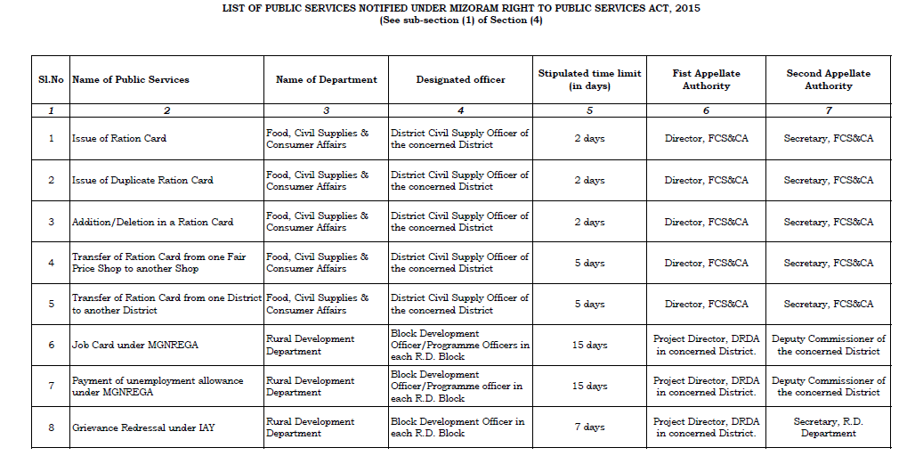
NOTIFICATION OF PUBLIC SERVICES

Slide 12
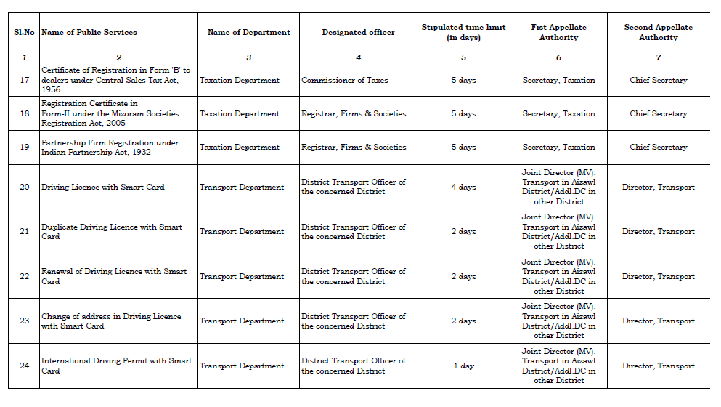
NOTIFICATION OF PUBLIC SERVICES

Slide 13
DISPLAY OF PUBLIC SERVICES
The Designated Officer shall display all relevant information relating to notified services for public convenience in Form 2 which shall include:
Designation of Designated Officer
First Appellate Authority
Second Appellate Authority
Stipulated time limit
Documents required to be enclosed with the application [Rule 5]

Slide 14
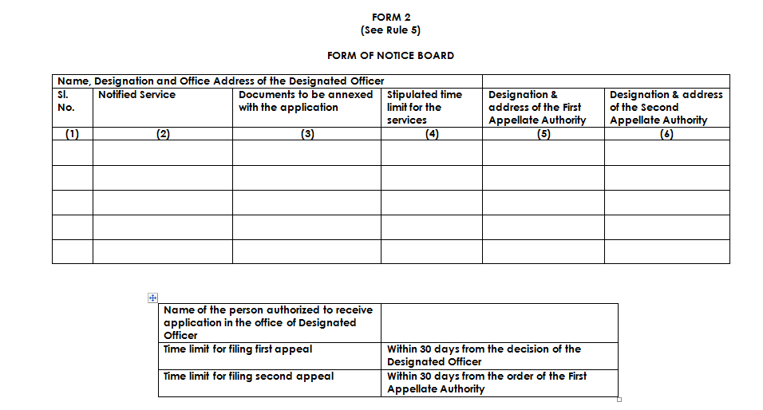

Slide 15
TIME BOUND DELIVERY OF SERVICES
Every eligible person shall have the right to obtain the services in accordance with this Act within the time bound period as notified under Sec 4(1) [Sec 5]
The Designated Officer shall provide the notified public services under Sec 4(1) to the eligible person within the stipulated time limit [Sec 6(1)]
The Designated Officer may seek the assistance of any other officer connected with the delivery of that particular notified service [Sec 6(2)]

Slide 16
TIME BOUND DELIVERY OF SERVICES
Any Officer whose assistance has been sought to render all assistance to the Designated Officer and shall also be treated as Designated Officer under this Act [Sec 6(3)]
The stipulated time limit shall start from the date when the application for obtaining a notified public service is received by the Designated Officer or by a person sub-ordinate to him so authorized to receive the application. [Sec 7(1)]
The Designated Officer, on receipt of an application, shall provide the notified public service or reject the application within the stipulated time limit [Sec 7(2)]

Slide 17
RECEIPT OF APPLICATION FOR SERVICES
The Designated Officer may receive or may, by order, authorize any subordinate officer or employee of the Department to receive the application made by any eligible person to obtain any notified service
He shall also issue the acknowledgement receipt to the applicant in Form-1 [Rule 3]

Slide 18
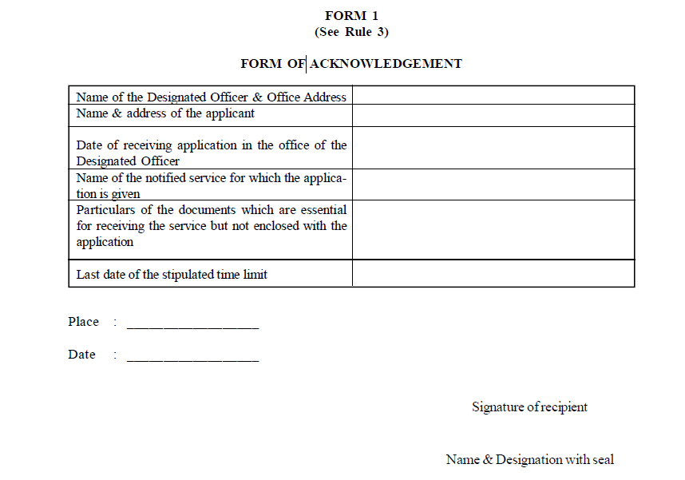

Slide 19
RECEIPT OF APPLICATION FOR SERVICES
In case all the essential documents for providing the notified service are not enclosed in the application, the last date of the stipulated time limit shall not be specified. [Rule 3]
While computing the stipulated time limit for providing notified services, Sundays and all other public holidays shall not be counted. [Rule 4]
“Public holiday” implies Sundays and any other day declared by the Government, by notification in the Official Gazette, as a public holiday [Explanation to Sec 25 of Negotiable Instruments Act, 1881]

Slide 20
REJECTION OF APPLICATION FOR SERVICES
In case of rejection of an application, the Designated Officer shall record the reasons in writing and communicate to the person making the application
the reasons for such rejection;
the period within which an appeal against such rejection may be preferred; and
the particulars of the First Appellate Authority [Sec 7(2)]

Slide 21
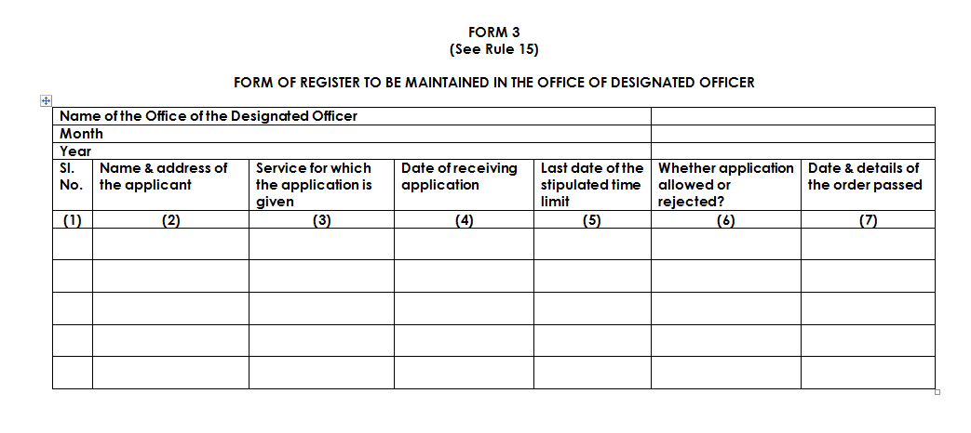

Slide 22
APPELLATE AUTHORITIES
The State Government may designate Appellate Authorities in respect of each notified public service for hearing appeals under the Act [Sec 4(3)] viz.
1. First Appellate Authority (FAA)
2. Second Appellate Authority (SAA)
The First Appellate Authority so designated for each of the notified services shall be higher in grade than the respective Designated Officer [Sec 4(4)]
Similarly, the Second Appellate Authority so designated for each of the notified services shall be higher in grade than the concerned First Appellate Authority [Sec 4(4)]

Slide 23
APPELLATE AUTHORITIES
The Appellate Authorities shall have the same powers as are vested in a Civil Court while trying a suit under the Code of Civil Procedure, 1908 in respect of the following matters, namely:-
requiring the production and inspection of documents;
issuing summons for hearing to the Designated Officer and the appellant, and
any other matter which may be prescribed [Sec 10]

Slide 24
FIRST APPEAL
Who can file First Appeal? | What are the grounds for making an Appeal? | Time limit for making an appeal | To whom can the first appeal be made?
A person making an application for notified public services | Rejection of an application OR failure to provide notified public services within time limit | 30 days (60 days in case appellant prevented by sufficient case from filing an appeal) | First Appellate Authority

Slide 25
FIRST APPEAL
The First Appellate Authority shall dispose of the appeal within a period of 30 days from the date of presentation of the appeal [Sec 8(2)]
First Appellate Authority shall provide a reasonable opportunity of being heard to the appellant and the Designated Officer before passing orders [Sec 8(3)]
The First Appellate Authority may order the Designated Officer to provide the notified service within such time as it may specify OR may reject the appeal [Sec 8(3)]
No fees for making first appeal [Rule 6]

Slide 26
SECOND APPEAL
Who can file Second Appeal? | What are the grounds for making an Appeal? | Time limit for making an appeal | To whom can the second appeal be made?
Designated Officer OR A person making an application for notified public services | Grievance with the order of the First Appellate Authority | 30 days (60 days in case appellant prevented by sufficient case from filing an appeal) | Second Appellate Authority

Slide 27
SECOND APPEAL
The Second Appellate Authority shall provide a reasonable opportunity of being heard to the appellant and the Designated Officer [Sec 9(2)]
The Second Appellate Authority may, within 30 days from the date of presentation of the appeal, pass an order directing the Designated Officer to provide the public service within such time as it may specify OR may pass such other order including rejection of the appeal
No fees for making second appeal [Rule 6]

Slide 28
PROCEDURE FOR DECIDING APPEALS
The relevant documents, public records or their copies shall be examined
The Designated Officer or appellant may be summoned at the time of hearing of appeal [Rule 9]
The notice of hearing of the first or second appeal, as the case may be, shall be served in any one of the following manners:
By the party or person himself;
By hand delivery through special messenger; or
By registered post with due acknowledgement receipt; or
Through the department [Rule 10]

Slide 29
PROCEDURE FOR DECIDING APPEALS
In all first or second appeals, the date of hearing shall be communicated to the applicant, the Designated Officer and the First Appellate Authority, as the case may be, at least seven working days in advance
Where it is clear that circumstances exist due to which an appellant, Designated Officer or First Appellate Authority as the case may be, is unable to be present in the hearing, in those cases, before taking final decision, at least one more chance may be given to the appellant, Designated Officer and First Appellate Authority for appearance [Rule 11]

Slide 30
PROCEDURE FOR DECIDING APPEALS
If any party remains absent after due service of notice of the fixed date of hearing, then the appeal shall be disposed of in his absence or dismissed due to non-appearance [Rule 11]
The copy of the order passed in the first or the second appeal, as the case may be, shall be communicated to the parties in writing from the First Appellate Authority or Second Appellate Authority. [Rule 12]

Slide 31
PENALTY
Two cases wherein First Appellate Authority can impose penalty [Sec 11(1)]:
Reasons for imposition of penalty | Amount of penalty | Upon whom penalty can be imposed
Failure to provide notified services without sufficient and reasonable cause | Between Rs 500/- and Rs 5,000/- | Designated Officer
Delay in providing notified services without sufficient and reasonable cause | Rs 250/- per day for such delay but not more than Rs 5,000/- | Designated Officer

Slide 32
PENALTY
Second Appellate Authority can impose the following penalty [Sec 11(2)]:
The penalty so imposed shall be in addition to that provided in any other Act, rules, regulations and notifications already existing [Sec 11(4)]
Reasons for imposition of penalty | Amount of penalty | Upon whom penalty can be imposed
Failure to decide appeal by FAA within time limit without sufficient and reasonable cause | Between Rs 500/- and Rs 5,000/- | First Appellate Authority

Slide 33
PENALTY
In case of imposition of a penalty under Section 11 of the Act, the First Appellate Authority or Second Appellate Authority, as the case may be, shall endorse a copy of the order to the concerned:
Drawing and Disbursing Officer, with the direction to recover the amount of penalty from the salary or honorarium or remuneration or contractual payment of the concerned Designated Officer, First Appellate Authority or person or agency concerned, as the case may be, after final disposal of appeal or expiry of appeal period, as the case may be;
Treasury Officer, wherever applicable; and
Department concerned. [Rule 12]

Slide 34
PENALTY : HEAD OF ACCOUNT

Slide 35
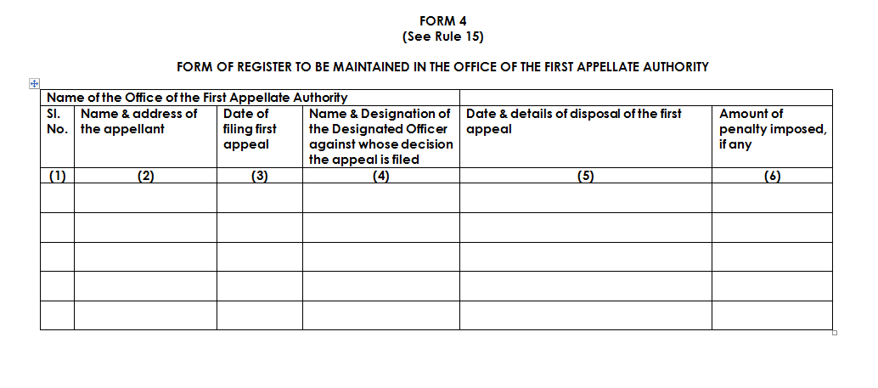

Slide 36
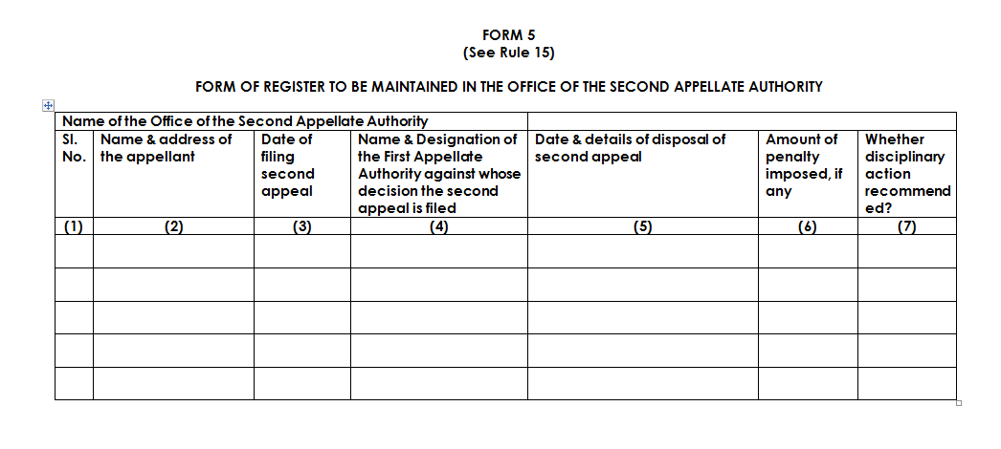

Slide 37
REVISION
Designated Officer or First Appellate Authority aggrieved by the orders of the Second Appellate Authority regarding imposition of penalty can make an application for REVISION to the Officer nominated by State Government [Sec 12]
Application for revision can be made within a period of 60 days
No fees for making revision of cases
Revision application can be accepted even after 60 days if application could not be submitted in time due to sufficient cause

Slide 38
REVISIONAL AUTHORITY

Slide 39
DISCIPLINARY ACTION
The Second Appellate Authority may recommend disciplinary action against the Designated Officer or the First Appellate Authority in addition to imposition of penalty under Sec 11
Failure to discharge the duties under the Act without sufficient and reasonable cause will be sufficient ground for recommendation of disciplinary action [Sec 13]

Slide 40
MISCELLANEOUS PROVISIONS
There is a bar on jurisdiction of Civil Court for any orders made under this Act [Sec 14]
Protection of action taken in good faith under this Act [Sec 15]
The Act to have overriding effect in respect of notified public services notwithstanding anything inconsistent therewith in any other law for the time being in force [Sec 16]

Slide 41
CHALLENGES AHEAD
More number of public services that are beneficial for citizens may be notified for time bound delivery under Section 4 of the Act
Develop an IT based mechanism for online monitoring of implementation of the Act
Generate greater awareness among the public about their rights to obtain notified public services in a time bound manner
Develop a mechanism for holding review meetings at the Chief Secretary/Secretary level for review of the field implementation of the Act

Slide 42
THANK YOU

